Slide 1
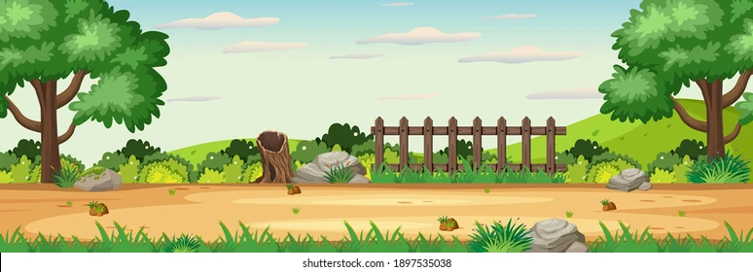


Hare And Tortoise

Slide 2
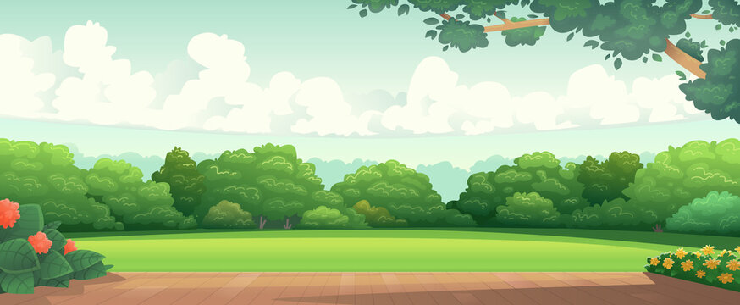
Once upon a time hare and tortoise lived in a jungle.The hare always boasted about how fast he could run , so the tortoise challenge him to a race.

Slide 3

Confident of winning , the hare ran a head and decided to rest under a tree.Meanwhile slow but steady tortoise kept moving and crossed the finish line.

Slide 4
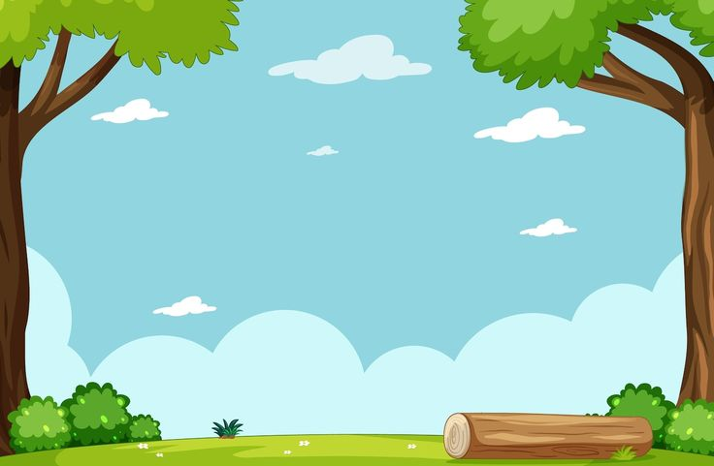
The hare woke up to late and learned that slow and steady wins the race.

Slide 5
THE END

